Slide 1
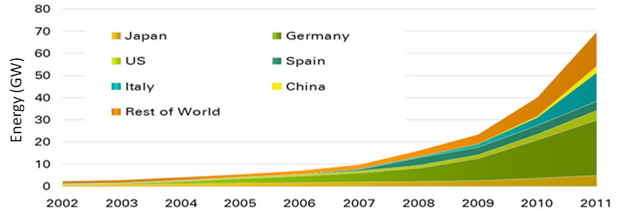
Solar Power Facts
Solar used to power spaceships since 1958 (www.renewableresourcesinc.com)
www.bp.com

Slide 2
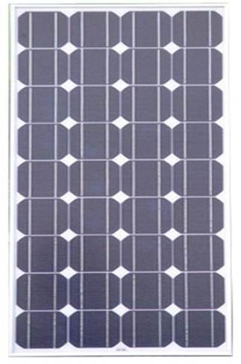
Photovoltaics
Photoelectric Effect
Some materials release electrons when struck by light
Photoelectric Cell
Two semiconductor wafers (e.g., Silicon)
One doped to have free electrons (e.g., Phosphor)
One doped to have shortage of free electrons,“holes” (e.g., Boron)
Photons strike free electrons, giving them enough energy to break free
Photoelectric Modules
Cells added in Series & Parallel to produce particular potential & current
www.supplierlist.com

Slide 3
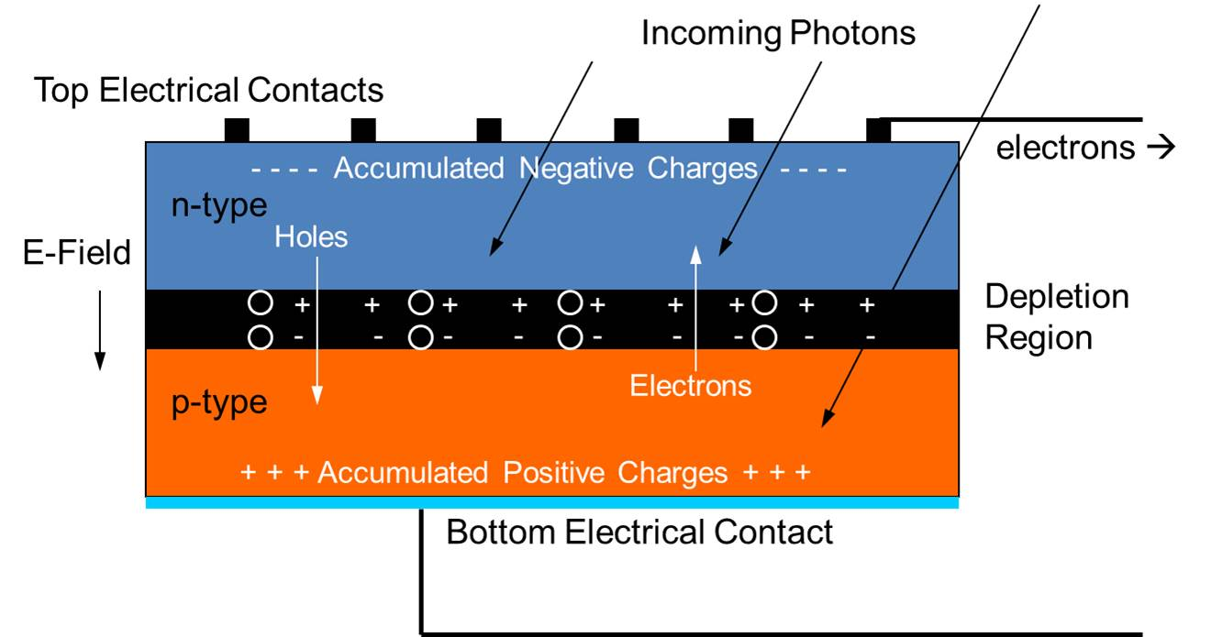
Photovoltaic
Jansson

Slide 4
PV Array
Cell
Module
Notes:
Module = panel

Slide 5
Electricity Basics
Potential (Voltage)
Current (Amperage)
Direct
Alternating
Resistance (Ohms)

Slide 6
Electricity vs Water
Electricity
Voltage, V
Potential, Volts, V
Current, I
Flow of Electrons, Amperes, Amp, A
Resistance, R
Resistance to flow, Ohms, Ω
Small wire, resister
Water
Notes:
V = IR
DC Steady flow, AC flow and pressure oscillate.
Water
Pressure, P
Force / Area
Flow, Q
Flow of Water Volume / Time
Headloss, H
Resistance to flow
Small pipe, valve, bend, constriction

Slide 7
Power, Direct Current: P = VI
Power, P = Work per unit time, Watts (W)
1 Watt = 1 Joule / second = 1 Volt Ampere
1 joule = 1 newton meter
1 volt = 1 joule/coulomb
1 coulomb = 6.24151·10¹⁸ electrons
1 ampere = 1 coulomb per second
Assume a 9 V battery has a capacity of ~600 mA hours (“m” = “1/1000”) If it creates a 60 mA current in a circuit:
Power = V I = 9 V x 60 mA = 540 mW = 0.54 W
It could last 600 mAh / 60 mA = 10 hours under ideal conditions
It could do 19,440 J of work under ideal conditions
9 V x 600 mAh x (3600 s/h) = 19,440 J
12,000 to 16,000 J is more realistic
It could lift can of soda (3.3. N) ~5,800 m at ~0.16 m/s under ideal conditions
0.54 N m s⁻¹ / 3.3 N = 0.16 m/s
19,440 J / 3.3 N = 5,800 m
Notes:
1 W = 1 joule per second
1 amp flowing through a potential of 1 volt = 1 W
1 Volt = 1 joule/coulomb
1 coulomb = 6.24151 × 10¹⁸ electrons
1 ampere = 1 coulomb per second
1 N = ~4.4 lb
12,000 to 16,000 J is more realistic. NON-IDEAL: motor efficiency, heat loss, cannot get all energy out of battery

Slide 8
PV Module Arrays
Modules combined in series & parallel to provide voltage & current for application
Modules make direct current (DC)
often connected to inverter to create alternating current (AC)
Excess power is
Notes:
Excess power is
put on grid,
stored in a battery, or
lost

Slide 9
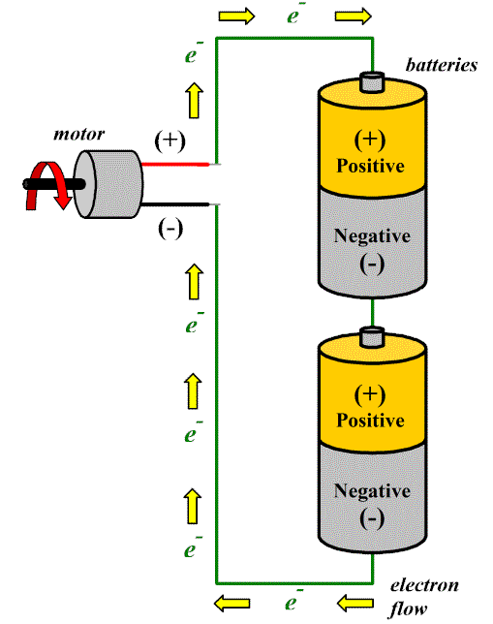
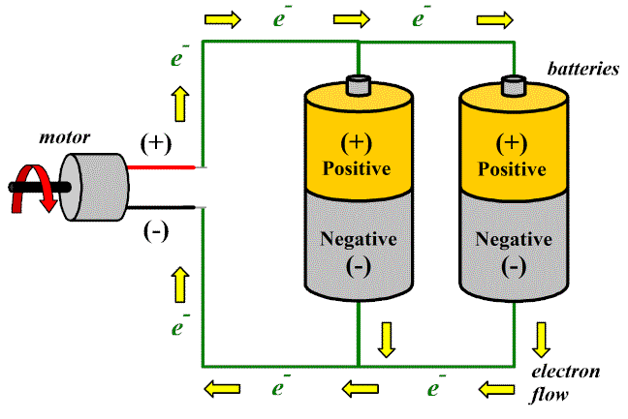
Batteries & PV Panels
Similarities
In Series: Increase Voltage
In Parallel: Increase Current
-
+
L
-
+
L
- +
- +
www.makeitsolar.com

Slide 10
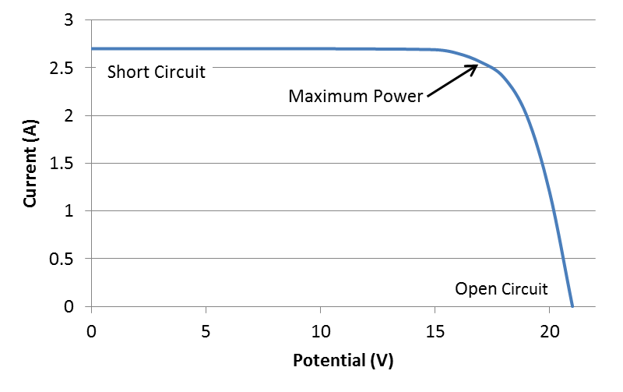
PV Solar Panel IV Curve
Connect
In
Parallel
Connect in Series

Slide 11
PV Technologies
Monocrystalline Silicon
Polycrystalline Silicon
Lower efficiency than mono, but cheaper to make
Amorphous Silicon (Thin Film)
Even lower efficiency, but even cheaper
Don’t require direct sunlight
Other
Organo PV
Thin-film Cadmium Telluride
Gallium –arsenide
Multijunction – Two layers of cells, trapping different bandwidths of solar rays
Notes:
Gevorkian, Solar Power in Building Design

Slide 12
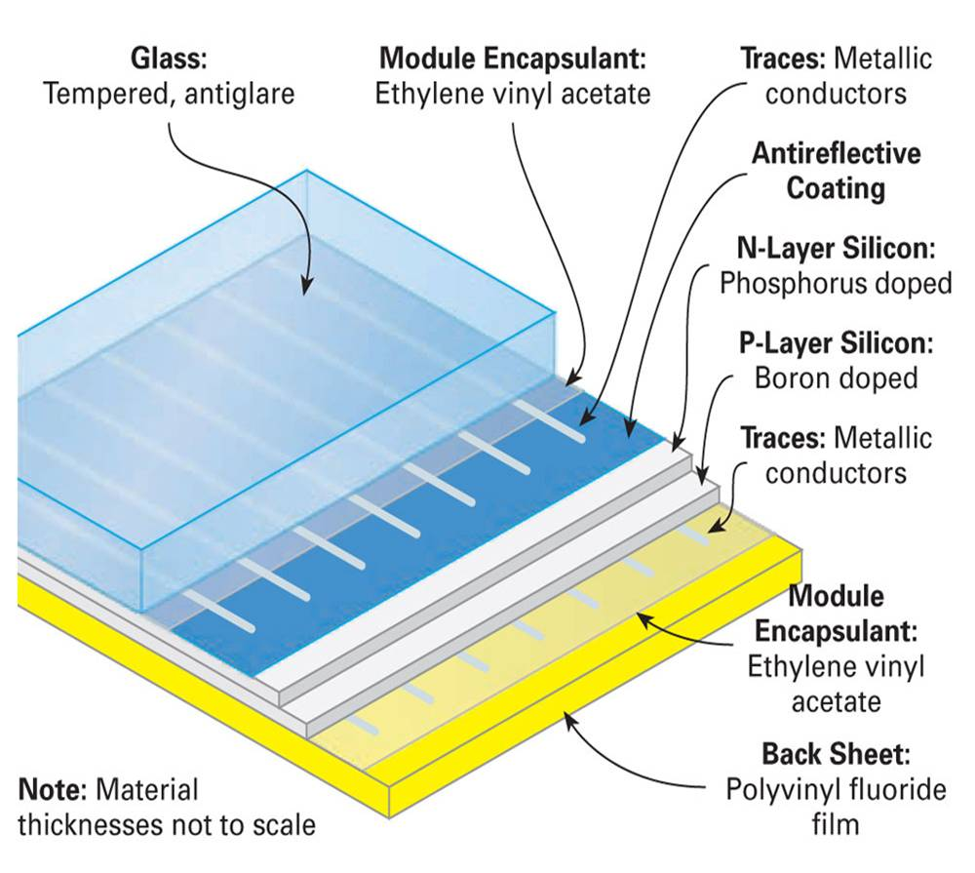
PV Module Layers (Silicon)
www.homepower.com
Notes:
kWp = kiloWatt peak
2014 – median cost of $5.3 found online

Slide 13
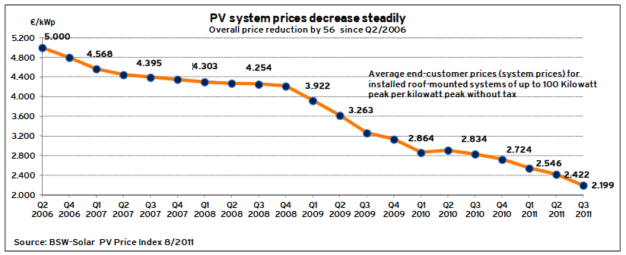
Money Euro/kWp installed (Germany) (Roof Mounted, under 100 kW)
www.greentechmedia.com
$2.80 in Germany versus $5.20 US
Notes:
kWp = kiloWatt peak
2014 – median cost of $5.3 found online

Slide 14
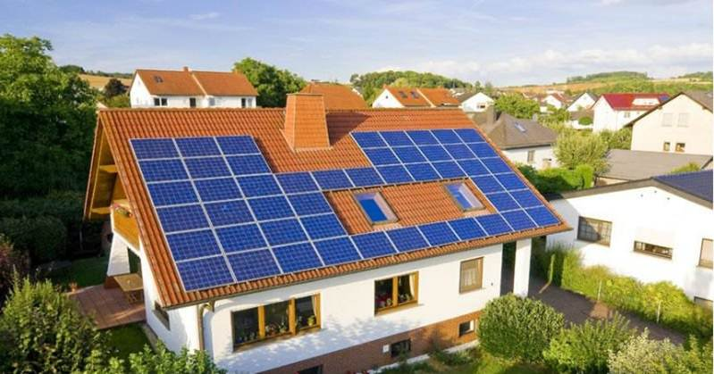
Inclined Roof PV
i00.i.aliimg.com

Slide 15

MegaSlate – PV & Roof Combined
www.3s-pv.ch
Notes:
Roof and PV combined

Slide 16
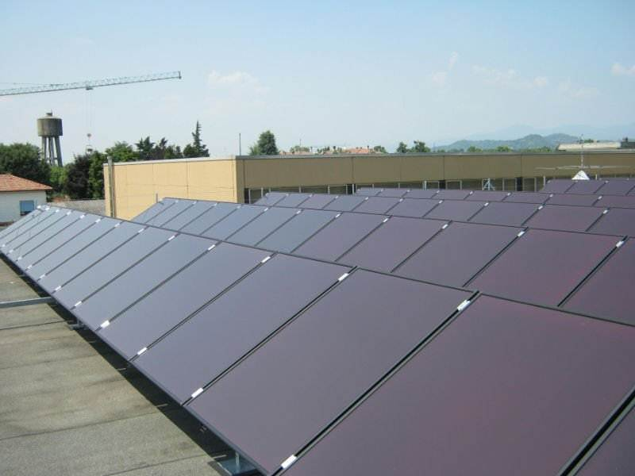
Flat Roof PV
i01.i.aliimg.com
Notes:
Ballasted Systems good on flat roofs

Slide 17
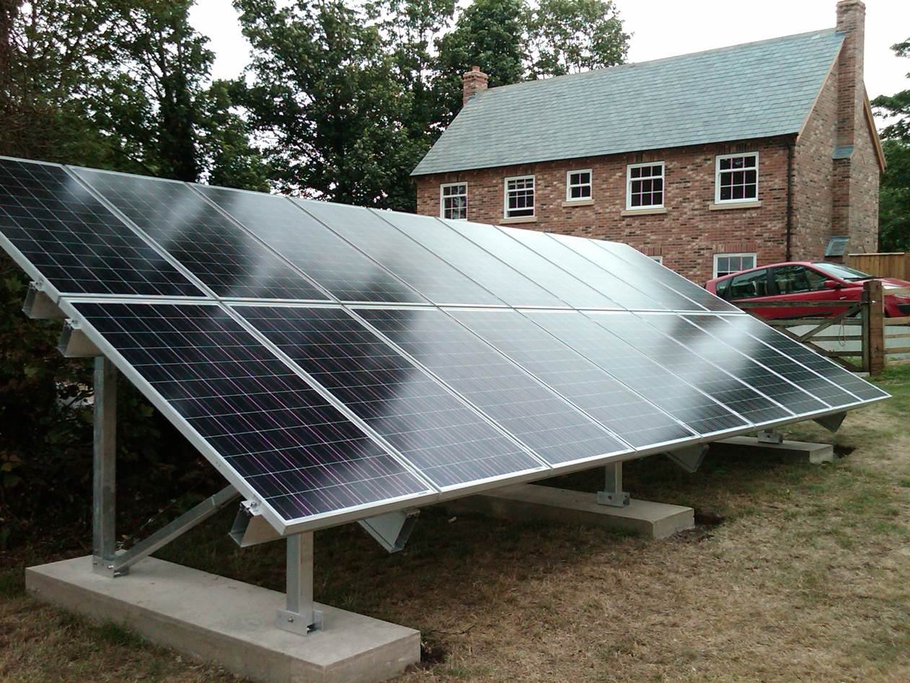
Ground Mount PV
www.daylightnorfolkcompany.co.uk
Notes:
Much better Foundations available!! E.g., screw in anchors

Slide 18
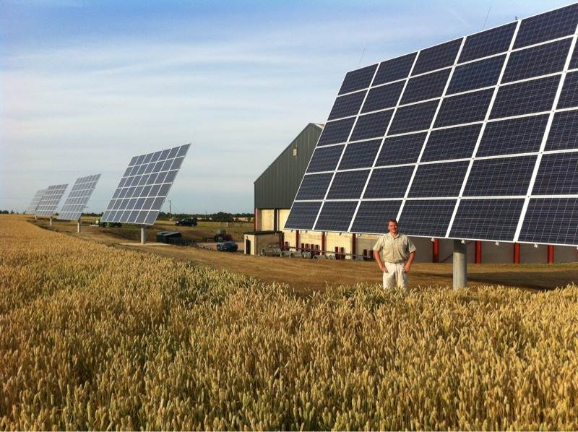
Ground Mount Tracking PV
www.nuffieldscholar.org

Slide 19
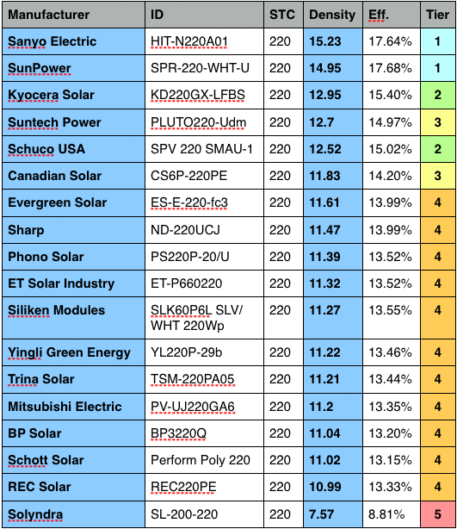
220 W Modules
sroeco.com
Amorphous →

Slide 20
Rating PV
Area efficiency (or Density)
Usable energy produced by a module per unit area.
A module that generates 210 Watts in 15 square feet ans a density of 210 W / 15 ft² = 14 W/ ft²
Module efficiency
Conversion of set amount of Sun energy to usable energy.
If module generates 15 W of electricity from 100 Watts of sun energy it is 15 % efficient
Cell efficiency
Same as module efficiency, but for single cell
Useful for tracking advances in cell technology, but does not always translate to module efficiency
Notes:
sroeco.com
‘Efficiency’ is calculated using the laboratory measurement called STC (Standard Testing Conditions). Whereas, ‘density’ uses the measurement system based on more realistic outdoor conditions, PTC (PVUSA Testing Conditions). It’s this difference in output under lab conditions (STC) versus real-world conditions (PTC) that causes the non-linear relationship between ‘efficiency’ and ‘density’.
www.solarpaneltalk.com
STC stands for Standard Test Conditions which are 1,000 watts per square meter solar irradiance, 1.5 Air Mass and 25 degrees C. cell temperature. PTC stands for PV USA Test Conditions which were developed at the PV USA test site at Davis, California. PTC are 1,000 watts per square meter solar irradiance, 1.5 Air Mass, and 20 degrees C. ambient temperature at 10 meters above ground level and wind speed of 1 meter per second.
[JWE: STC done with Flash lamp, PTC done with continuous source to measure real life harvest]
sroeco.com
There are 3 main types of solar efficiency.
1. Module Efficiency 2. Area Efficiency (Density) 3. Cell Efficiency
1. Module efficiency measures how well a solar module (aka panel) converts the Sun’s energy into usable energy. If the Sun dumps 100 Watts of energy onto the module and the module spits out 15 Watts, the the module is said to have 15% module efficiency (15 W / 100 W = 0.15 = 15%). If you want to brag to your friends that you have a top tier efficiency panel, care about this.
2. Area efficiency (aka Density) measures how much usable energy a module produces in a given area. It’s Watts per square foot, so the more Watts, the more energy you’ll get from a specific area (or available space on your roof). So if a module spits out 210 Watts in 15 square feet, it’s density is… c’mon, it’s Watts per square feet (and I made it an easy number). Okay, it’s 14 W/sqft (= 210 W / 15 sqft). If you have limited roof space, get the panel with the highest density.
3. Cell efficiency is measured the same way as module efficiency, but only with a single cell. This is the number news media and blogs love to tout in their headlines as ‘record breaking’ and ‘highest efficiency achieved’. This number is generally not useful for the average consumer. If you work in a solar cell lab, don’t give up on increasing this number.
So that’s the basics of solar efficiency. Now, let’s make it even simpler by dividing solar panels into 5 Efficiency Tiers (or levels).
[JWE-1000W/m² is typical energy density from sun]

Slide 21
Types of PV Systems
Stand-Alone DC
Stand-Alone DC w/ Battery Backup
Stand-Alone AC w/ Battery Backup
Grid Connected AC
Notes:
Stand-Alone DC w/ Battery Backup – Charge Controller
Stand-Alone AC w/ Battery Backup & Grid Connected AC – Inverter
Stand-Alone DC
DC well pump with tank
Stand-Alone DC w/ Battery Backup
Weather Station
Stand-Alone AC w/ Battery Backup
Off Grid Home
Grid Connected AC
On Grid Home

Slide 22
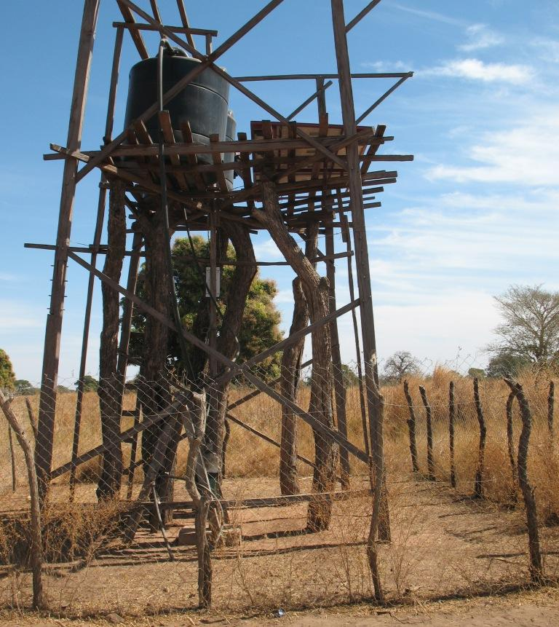
Stand-Alone DC: The Gambia

Slide 23
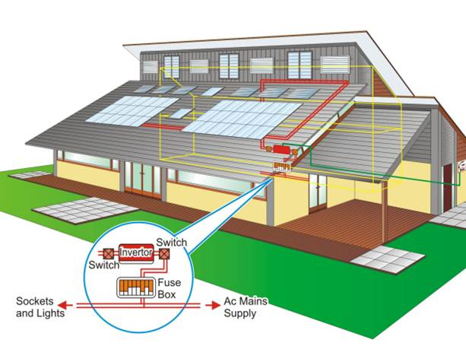
Grid Connected AC
www.ohmg.org.uk

Slide 24
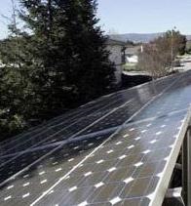
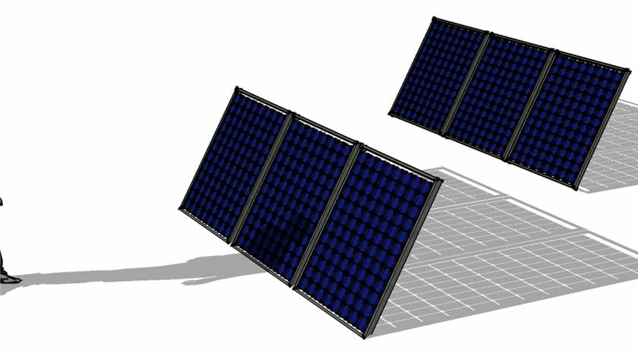
Site Specific Design
engineering.electrical-equipment.org
Array Tilt
Array Azimuth
Shading
Partial shading can have significant negative effect
Array
Part of a module
Source of Shade
www.civicsolar.com
Notes:
Source of Shade
Surroundings (trees, buildings)
Other Panels (self shading)

Slide 25
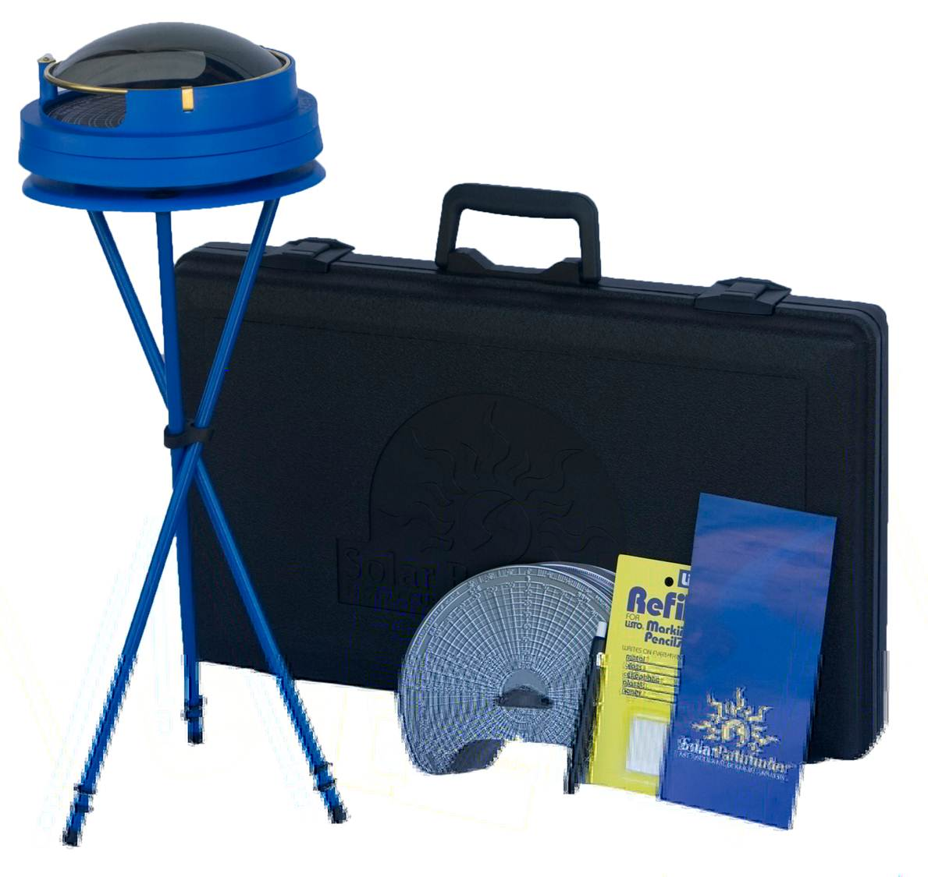
Surroundings: Solar Path Finder
av.solarpathfinder.com

Slide 26
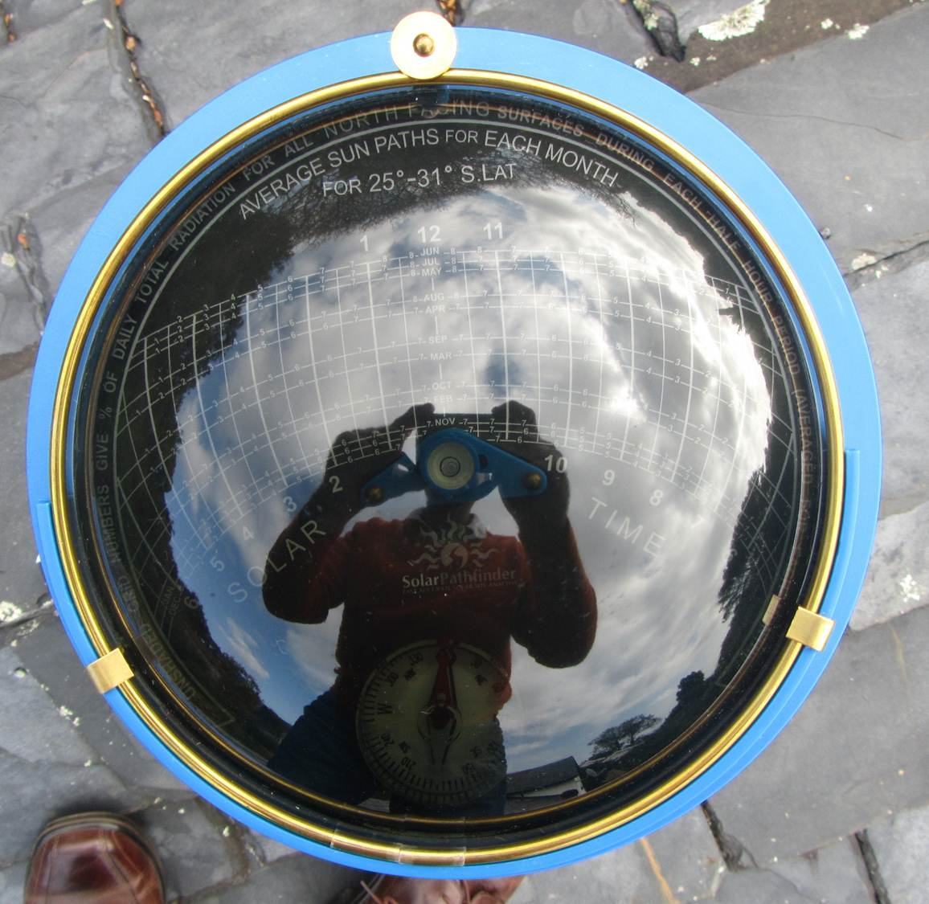
Trace Surroundings
gorgeousgreenhouse.files.wordpress.com
↓
Analyze with software
www.solarpathfinder.com
Click FAQ menu,
Select “Software Free Trial Version”

Slide 27
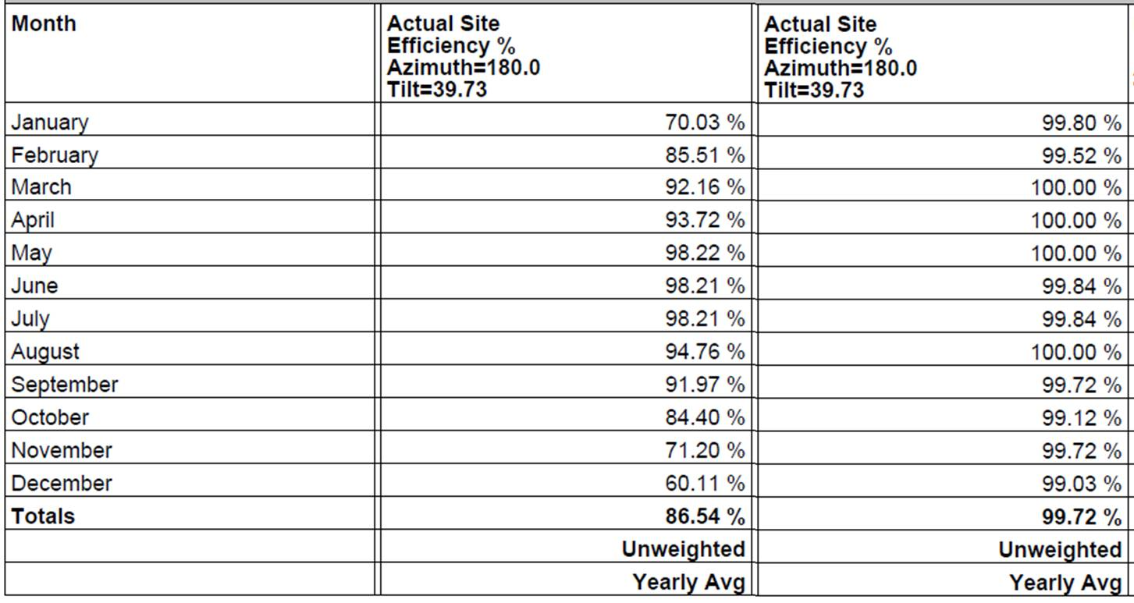
Solar PathFinder Output
Shaded Site
(Proper Trace)
Unshaded Site
(Traced outer edge)

Slide 28

Shade FROM PV
www.solartechnologies.co.uk

Slide 29
Tilt and Azimuth
PV Panel
Top View
PV Panel
North
L
Array Tilt
Array Azimuth
North
Side View
W
Array Azimuth
Due South is best (Array Azimuth = 180°)
Array Tilt ≈ latitude is best for all year fixed angle
Flatter better in summer Steeper better in winter
(Ignoring cloud seasonality)
When do you need electricity?
Is the cost seasonal?
PV Panel
Array Tilt = A
Ground Surface
or Flat Roof
Notes:
greenliving.nationalgeographic.com
Step 1: Calculate the exact southern orientation for positioning your panels. Begin with a compass to find magnetic north, and accordingly, south. Figure the magnetic declination -- the angle between magnetic south and true south -- for your geographic location, using an online calculator such as the one available from the National Geophysical Data Center. Add the magnetic declination to the directional indicator on your compass if the declination is east, or subtract if the declination is west (see References 1, Question 5d). By ensuring your PV array faces true south, you optimize the efficacy of your panel tilt.
Step 2: Calculate the optimum tilt angle, based on the latitude -- your angular distance north or south from the equator expressed as degrees along a meridian -- of your location (see References 3). To find your latitude, consult a map for your region. Find the best angle for optimizing solar collection during winter, when solar energy is most scarce, by multiplying your latitude by 0.89, and then adding 24 degrees. For instance, if your latitude is 45 degrees: 45 x 0.89 = 40.05 + 24 = 64.05. In this example, you would tilt your solar panels at a 64-degree angle from a horizontal level (see References 2).
Step 3: Decide whether you wish to leave your panels at the optimum winter tilt all year long, or whether you prefer to adjust them for each season. Factors that might affect your decision include the accessibility of your PV array and whether you expect more sunlight than you can use during the summer months, in which case you need not adjust your tilt. If you do plan to optimize solar collection in every season, use the following calculations: For spring and fall, multiply your latitude by 0.98 and subtract 2.3 degrees. For summer, multiply latitude by 0.92 and subtract 24.3 degrees to get your solar panel tilt angle. (See References 2.)

Slide 30
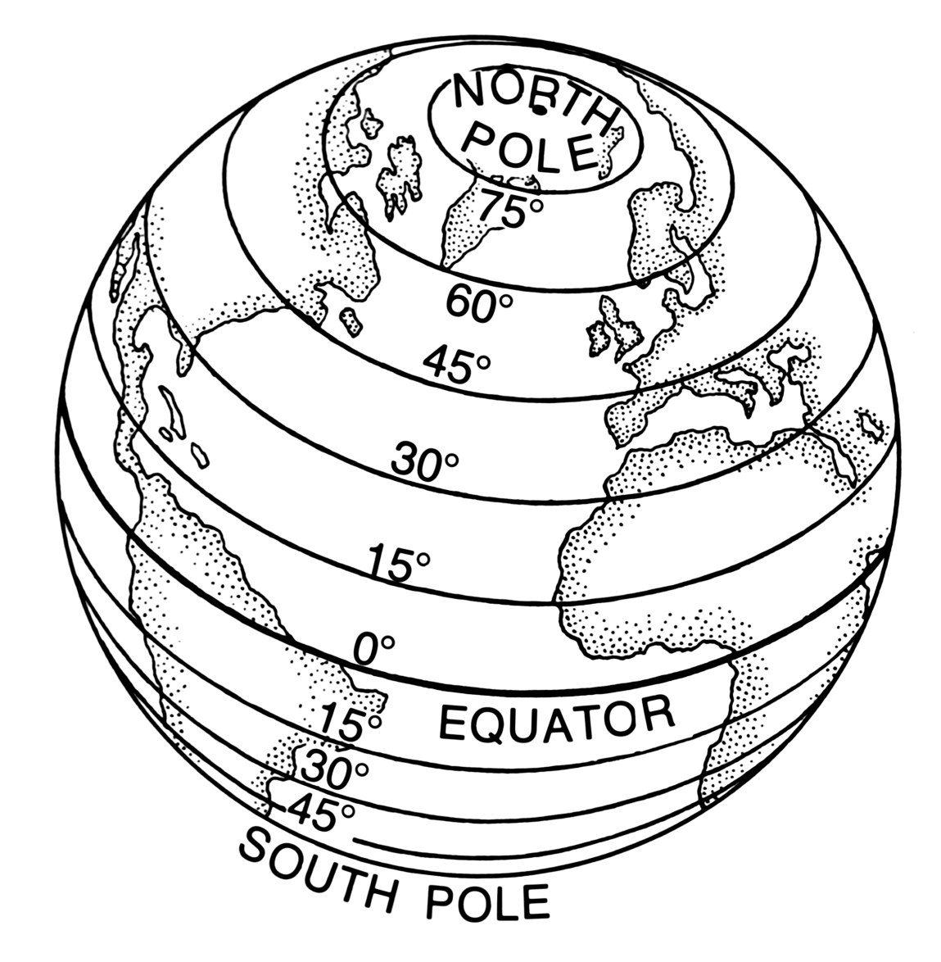
Latitude
www.techdigest.tv
Imaginary lines that circle earth parallel to equator
Location specified by angle between lines from center of earth to equator and latitude
Glassboro ~ 39.8 °

Slide 31
Fixed Tilt (All Year)
Latitude below 25 °
Array Tilt Angle, A_{ay} = 0.87 Lat
Where Lat = Latitude in decimal degrees
Latitude between 25 ° & 50°
Array Tilt Angle, A_{ay} = 0.76 Lat + 3.1°
Example 1: latitude = 20°
Example 2: latitude = 45°
According to: Macs Lab; Optimum Orientation of Solar Panels; Charles R. Landau; April 2011
Notes:
Macs Lab; Optimum Orientation of Solar Panels; Charles R. Landau; April 2011
Example 1: latitude = 45°
0.87·45° = 39.15°
Example 2: latitude = 20°
0.76·20° + 3.1° = 15.2° + 3.1° = 18.3°

Slide 32
Seasonal Array Tilt
greenliving.nationalgeographic.com
Winter
Array Tilt Angle, A_{w} = 0.89 Lat + 24°
Spring and Fall
Array Tilt Angle , A_{sf} = 0.98 Lat – 2.3°
Summer,
Array Tilt Angle , A_{s} = 0.92 Lat – 24.3°
Example 3: latitude = 45°
Winter:
Spring and Fall:
Summer :
Notes:
Macs Lab; Optimum Orientation of Solar Panels; Charles R. Landau; April 2011
Northern hemisphere/Southern hemisphere
Adjust to summer angle on April 18/October 18
Adjust to autumn angle on August 24/February 23
Adjust to winter angle on October 7/April 8
Adjust to spring angle on March 5/September 4
Example 3: latitude = 45°
Winter: 0.89·45° + 24° = 40.5° + 24° = 64.5°
Spring and Fall: 0.98·45° – 2.3° = 44.1° – 2.3° = 41.8°
Summer : 0.92·45° = 41.4° - 24.3° = 17.1°

Slide 33
Array Tilt & Shading
Flat Roof or Ground Applications
Larger the Tilt, farther rows need to be apart to avoid shading each other
~15° sometimes used to minimize shading & maximize summer production
Panels installed at roof angle on inclined roofs
Ground Surface or Flat Roof

Slide 34
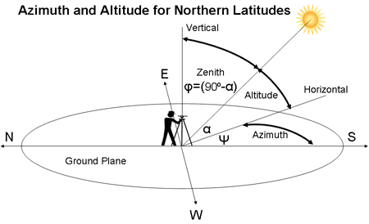
Inter-Row Distance (South Facing Array)
h
d_{m} = h cosψ / tanα
d_{m} = minimum inter-row distance w/ no inter-row shading on winter solstice (Dec 21) between specified hours
α = sun altitude angle (alpha)
ψ = sun azimuth (psi)
d_{m}
L
h
A
p
h = L sin(A), where A = Array Tilt Angle
p = L cos(A)
solarwiki.ucdavis.edu
Notes:
Ken Gardner, Method from Calculating Inter-Row Spacing, Energy Trust of Oregon, http://energytrust.org/trade-ally/updates-and-events/InsiderNewsletter/insider-pdfs/100304_solarprofessional_article.pdf, Dec/Jan 2009

Slide 35
Sun Path Chart → α & ψ
Pick desired shade free period on Dec 21
10 AM to 2 PM
9 PM to 3 PM
Use Univ. of Oregon online program to obtain Sun Path Chart
solardat.uoregon.edu/SunChartProgram.php
Enter zip code (step 1), specify time zone (step 2), select file format (step 6), enter Verification code (step 7) and click “Create Chart” Button
Notes:
All other days will be shade free longer
solardat.uoregon.edu/SoftwareTools.html

Slide 36
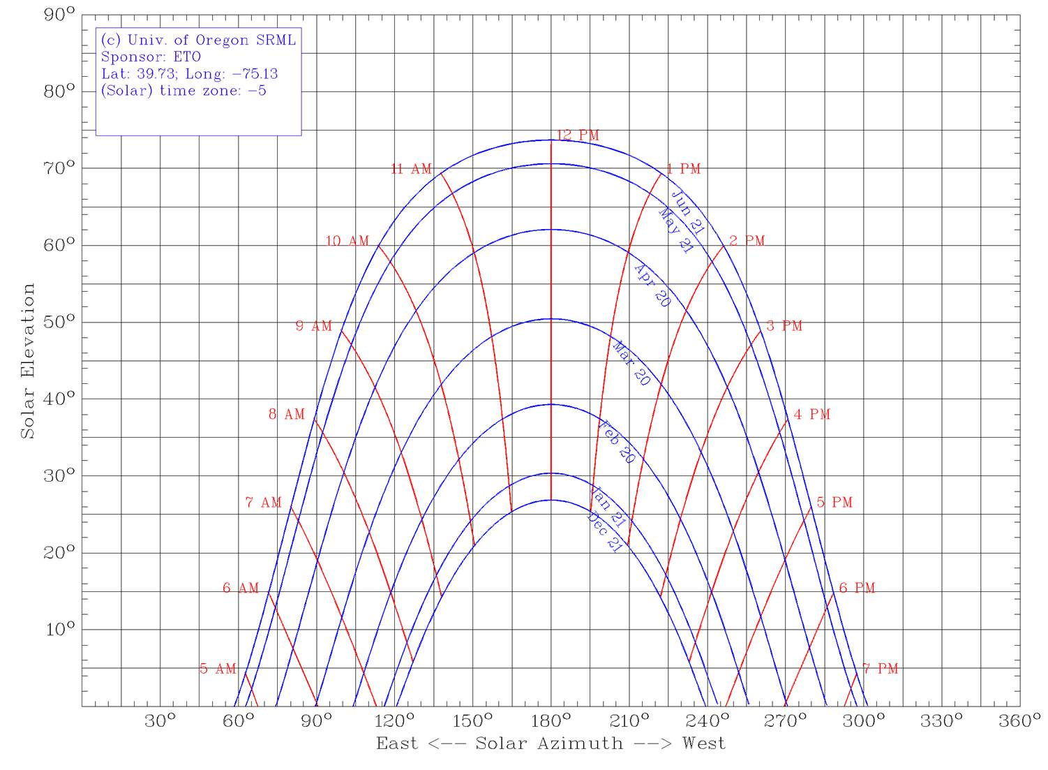
Sun Chart – Pitman NJ
→
←
α = 14°
Example 4 on next slide
ψ = 180 – 138 = 42°
ψ = 220 – 180 = 42°

Slide 37
Example 4: Pitman NJ
Let
Location = Pitman, NJ
h = 0.7 m
No shade desired on Dec. 21 from 9 AM to 3 PM
From Sun Path Chart
α =
ψ =
d_{m} = h cosψ / tanα = 0.7·cos42° / tan14°
=
Notes:
From Sun Path Chart
α = 14°
ψ = 42°
d_{m} = h cosψ / tanα = 0.7·cos42° / tan14°
= 0.7 · 0.743 / 0.249 = 2.1 m

Slide 38
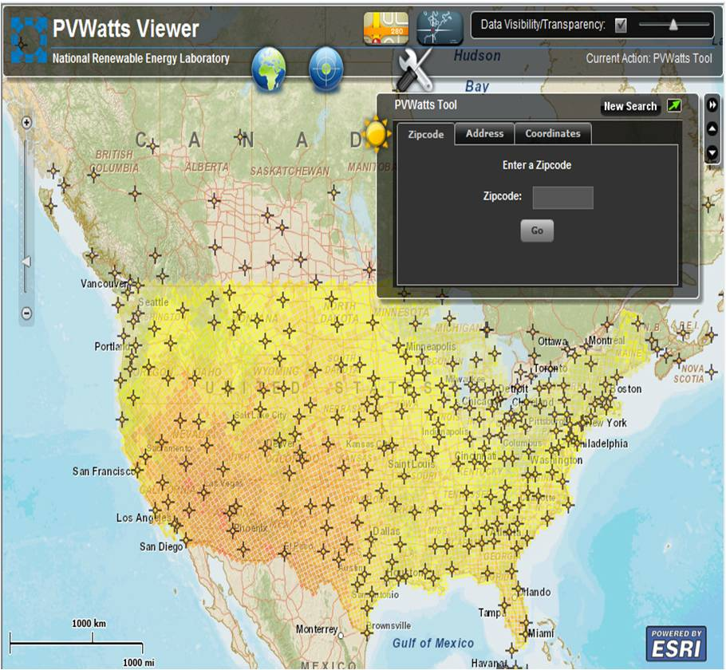
PVWatts™ Grid Data Calculator (Version 2) (www.nrel.gov/rredc/pvwatts/grid.html)
Enter Zipcode

Slide 39
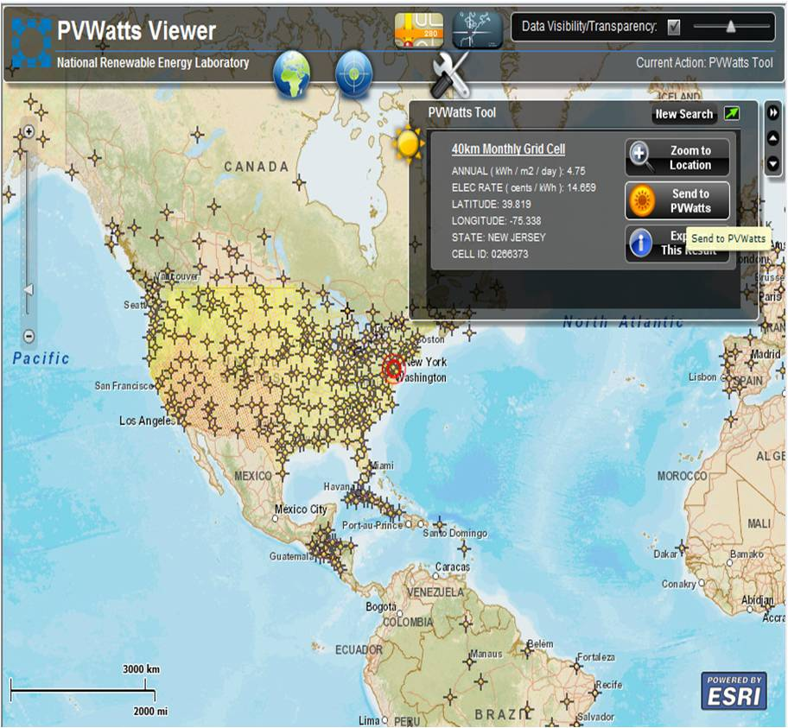
Click “Send to PVWatts”

Slide 40
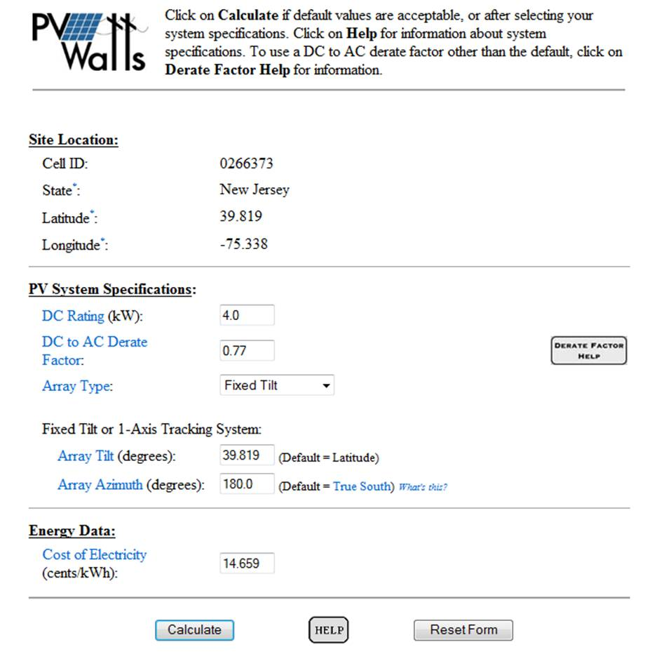
DC Rating: Module W rating x # of Modules
DC to AC Derate Factor: Efficiency producing AC
Array Type: Fixed, one axis, two axis
Array Tilt: Angle from ground
Array Azimuth: Direction from N

Slide 41
Derate Factors for AC Power Rating at STC
Component Derate Factors | PVWatts Default | Range
PV module nameplate DC rating | 0.95 | 0.80–1.05
Inverter and transformer | 0.92 | 0.88–0.98
Mismatch | 0.98 | 0.97–0.995
Diodes and connections | 0.995 | 0.99–0.997
DC wiring | 0.98 | 0.97–0.99
AC wiring | 0.99 | 0.98–0.993
Soiling | 0.95 | 0.30–0.995
System availability | 0.98 | 0.00–0.995
Shading | 1.00 | 0.00–1.00
Sun-tracking | 1.00 | 0.95–1.00
Age | 1.00 | 0.70–1.00
Overall DC-to-AC derate factor | 0.77 | 0.09999–0.96001
We won’t change any of these
Notes:
http://www.nrel.gov/rredc/pvwatts/changing_parameters.html#dc2ac
DC Rating
The size of a photovoltaic (PV) system is its nameplate DC power rating. This is determined by adding the PV module power listed on the nameplates of the PV modules in watts and then dividing the sum by 1,000 to convert it to kilowatts (kW). PV module power ratings are for standard test conditions (STC) of 1,000 W/m² solar irradiance and 25°C PV module temperature. The default PV system size is 4 kW. This corresponds to a PV array area of approximately 35 m² (377 ft²).
Caution: For correct results, the DC rating input must be the nameplate DC power rating described above. It cannot be based on other rating conditions, such as PVUSA test conditions (PTC). PTC are defined as 1,000 W/m² plane-of-array irradiance, 20°C ambient temperature, and 1 m/s wind speed. If a user incorrectly uses a DC rating based on PTC power ratings, the energy production calculated by the PVWatts calculator will be reduced by about 12%.
Back to Top
DC-to-AC Derate Factor
The PVWatts calculator multiplies the nameplate DC power rating by an overall DC-to-AC derate factor to determine the AC power rating at STC. The overall DC-to-AC derate factor accounts for losses from the DC nameplate power rating and is the mathematical product of the derate factors for the components of the PV system. The default component derate factors used by the PVWatts calculator and their ranges are listed in the table below.

Slide 42
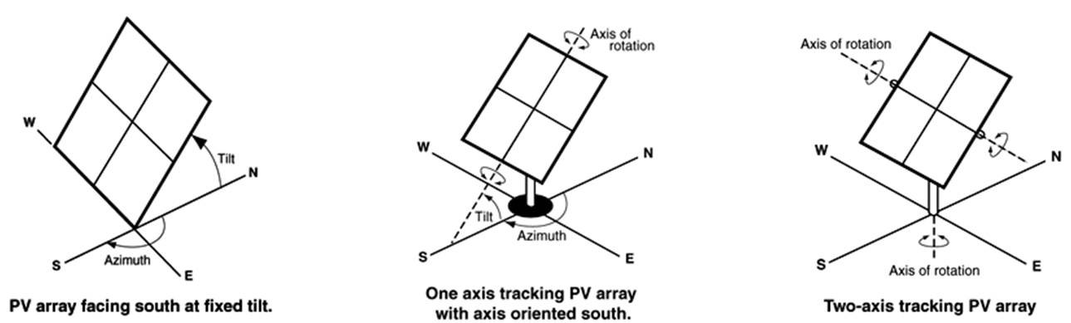
Fixed versus Tracking Arrays
www.nrel.gov
We will stick to the “fixed tilt” option

Slide 43
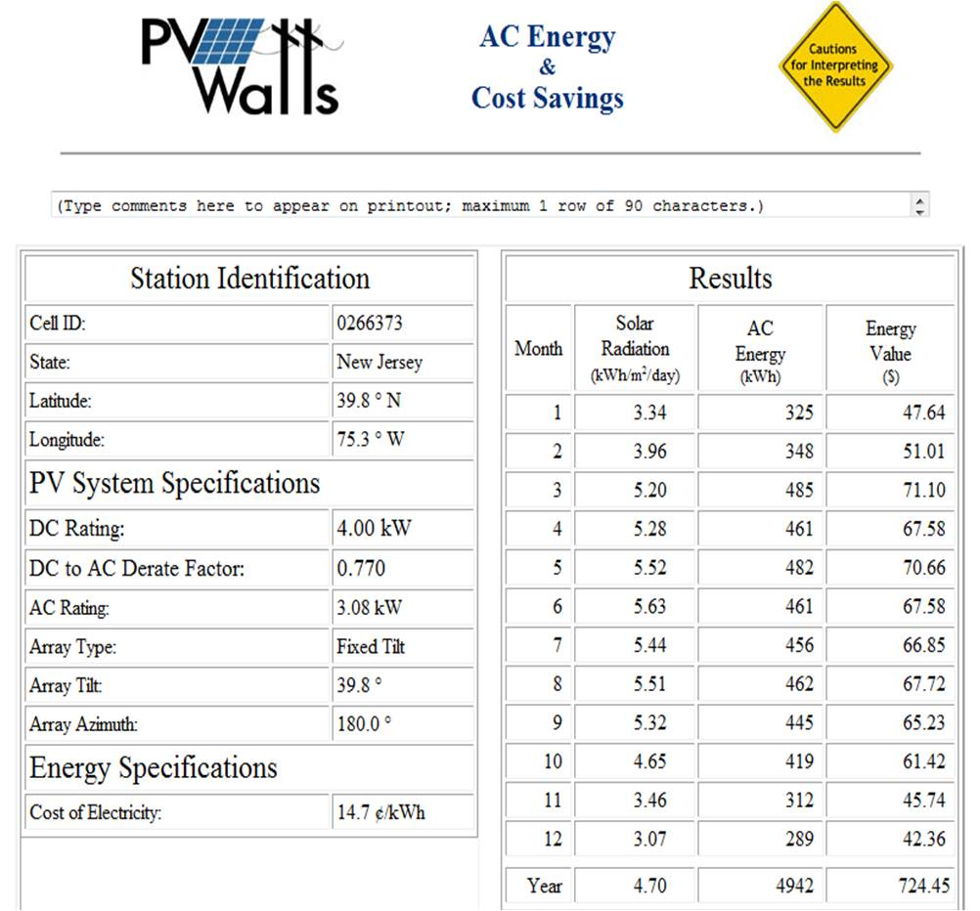

Slide 44
Example 5: Energy / Area
Sharp ND-200 U1
Poly-Crystalline
1.6 m x 1 m
L = 1.6 m, W = 1 m
200W per panel
Open Circuit Voltage = 35.5 V
Short Circuit Current = 7.82 A
Module Efficiency = 12.3 %
Fixed Tilt System on flat roof
Try two Tilt Angles
A_{ay}
15°
Use Pitman Sun Data
α = 14° & ψ = 42°
Roof is 10 m wide in East/West direction
Electricity is $0.1/kWh
Notes:
Sharp ND-200 U1
Poly-Crystalline
1.6 m x 1 m
L = 1.6 m, W = 1 m
200W per panel
Open Circuit Voltage = 35.5 V
Short Circuit Current = 7.82 A
Module Efficiency = 12.3 %
Optimum All Year Array Tilt, A_{ay}

Slide 45
Example 5
How many panels does a “4 kW” system need?
Optimum All Year Array Tilt, A_{ay} =
h =
d_{m} = h cosψ / tanα =
=
(ψ & α from previous example)
Notes:
1200 NJ rule of thumb for conversion from kW to kWh for year
How many panels does a “4 kW” system need?
4000 W / 200 W = 20
Optimum All Year Array Tilt, A_{ay} = 0.87 · 39.73° = 34.6°
h = 1.6 m · sin 34.6° = 0.91 m
d_{m} = h cosψ / tanα = 0.91 · cos42° / tan14°
= 0.91 · 0.743 / 0.249 = 2.7 m
(ψ & α from previous example)

Slide 46
Example 5
Use PVWatt 2 to estimate the annual kWh & Savings from the Array
4791 kWh
$479

Slide 47
Example 5
What if you reduced the Array Tilt Angle to 15°?
h =
d_{m} = h cosψ / tanα =
=
Use PVWatt 2 to estimate the annual kWh & Savings from the Array
4761 kWh
$461
Notes:
What if you reduced the Array Tilt Angle to 15°?
h = 1.6 m · sin 15° = 0.41 m
d_{m} = h cosψ / tanα = 0.41 · cos42° / tan14°
= 0.41 · 0.743 / 0.249 = 1.2 m
Use PVWatt 2 to estimate the annual kWh & Savings from the Array
4761 kWh
$461

Slide 48
Example 5
Plan Area of Array, A_{p} = (N ⋅ W) ⋅ (R ⋅ p + (R-1) ⋅ d_{m})
N = Number of panels per row
R = Number of rows
Equation works for any N and R
N ⋅ W
p
d_{m}
R ⋅ p + (R-1) ⋅ d_{m}

Slide 49
Example 5
Determine the Array Area for each Title Angle
20 panels, each with W = 1 m; 10 m wide Roof
Array Tilt = 39.71°
A_{p} =
Array Tilt = 15°
A_{p} =
Notes:
Determine the Array Area for each Title Angle
20 panels, each with W = 1 m; 10 m wide Roof
Two rows of 10 panels each
R = 2; N = 10
Array Tilt = 39.71°
A_{p} = (2·1.6 m·cos(34.6°)+1·2.7 m)] = 53.3 m²
Array Tilt = 15°
A_{p} = [10 m · (2·1.6 m·cos(15°)+1·1.2 m)] = 42.9 m²

Slide 50
Example 5
Does the tilt angle effect the Energy produced per Array Area?
Array Tilt = 39.71°
Array Tilt = 15°
Notes:
Does the tilt angle effect the Energy produced per Array Area?
Array Tilt = 39.71°
4791 kWh / 53.3 m² = 89.9 kWh/m²
Array Tilt = 15°
4761 kWh / 42.9 m² = 111 kWh/m²

